Slide 1
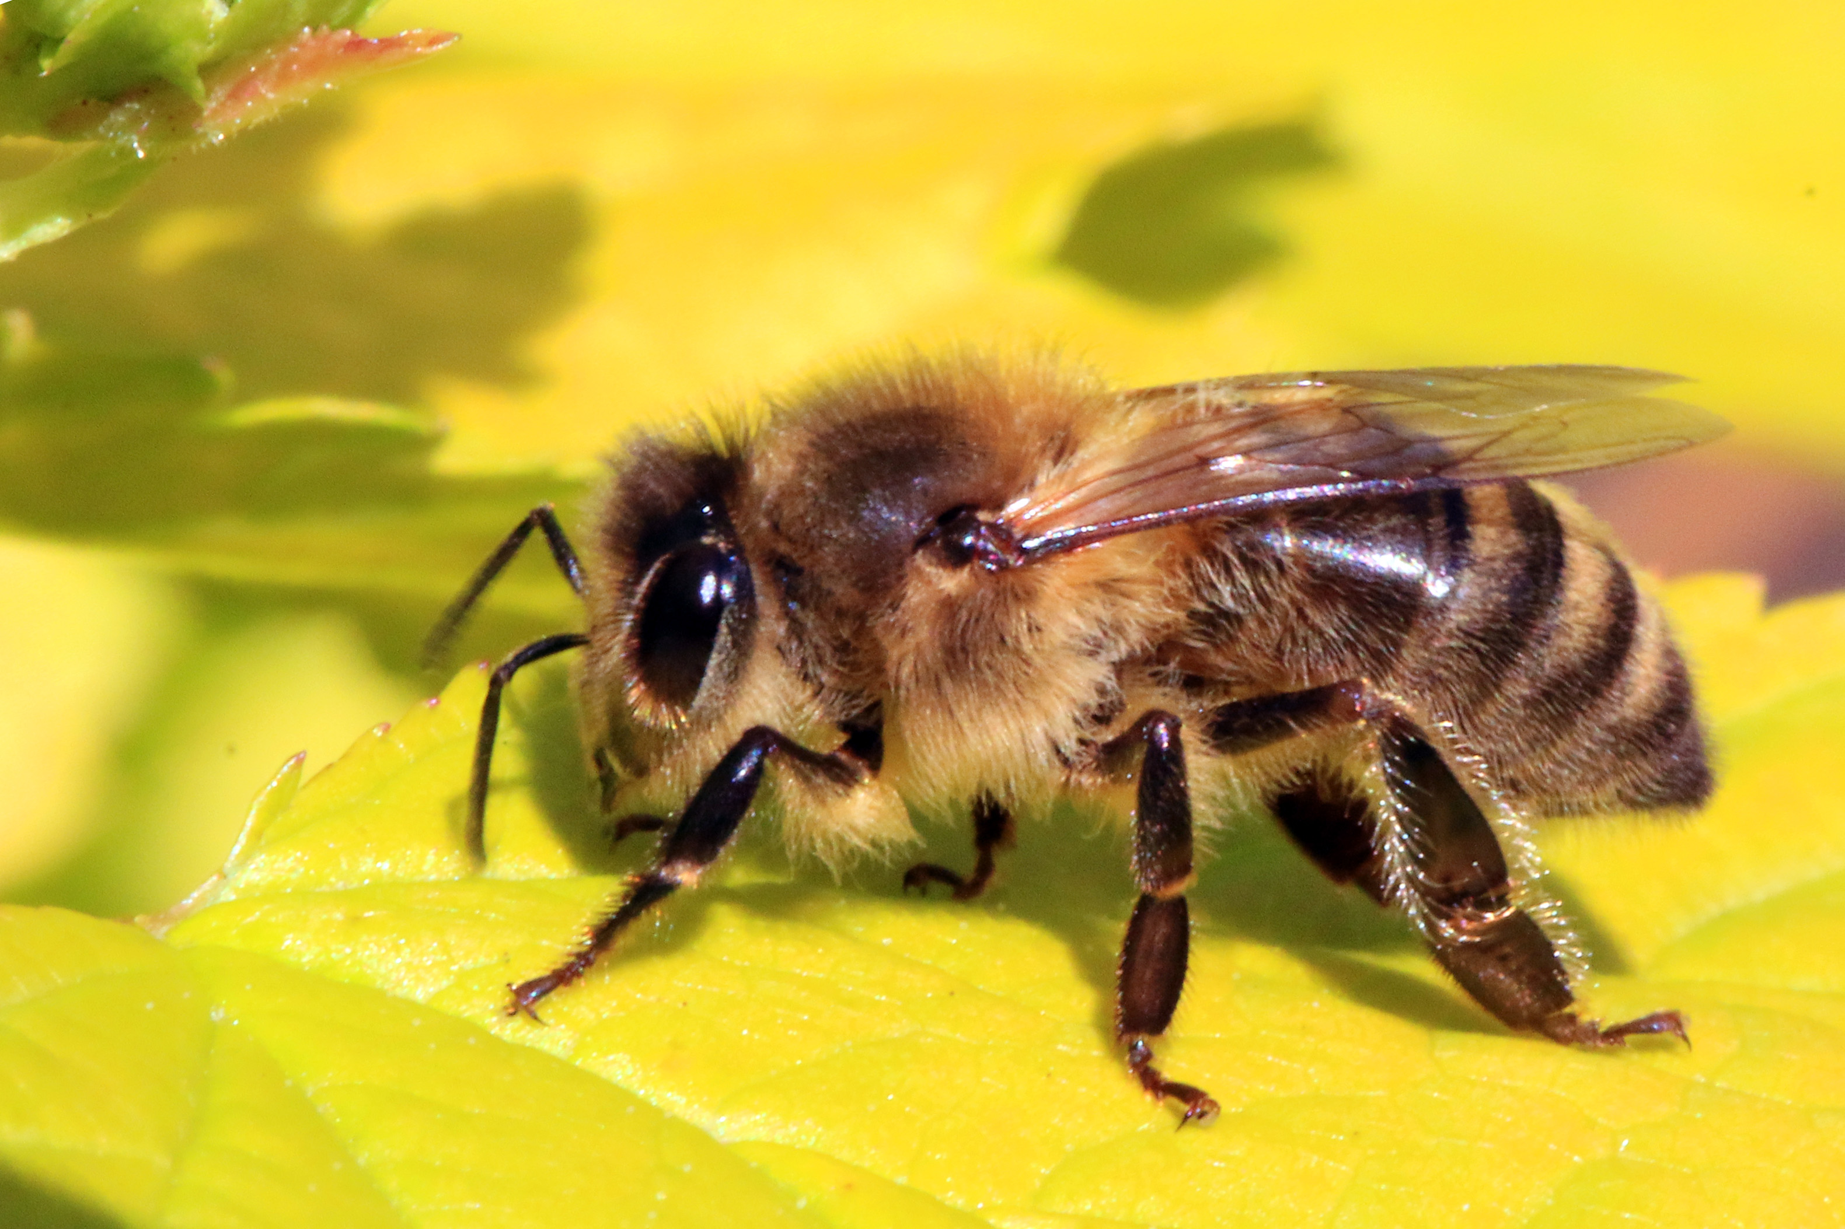

Slide 3
Bee keeping
Bee keeping or Apiculture is the rearing, care and management of honeybees for obtaining honey, wax etc
Bee keeping has become an important industry in India among farmers for the production of honey and other resources.

Slide 4
Products obtained from Apiculture
Honey: It’s a sweet viscous edible fluid containing sugars, water, minerals, vitamins, amino acids, enzymes and pollen. It’s made from nectar of flowers
Bee Wax: It’s a wax of high melting point. This wax is used by humans for purposes like manufacturing of ointments, cosmetics, cold creams, candles, lubricants etc

Slide 5
Honey Bee Varieties
Indian Varieties:
Apis cerana Indica F. (Indian Bee)
Apis dorsata F (Rock Bee)
Exotic varieties
Apis mellifera (Italian bee)
Apis adamsoni (South African bee)

Slide 6
Classes of Honeybees
Honey bees live in a colony. They divide work based on their class
The classes are:
Queen: The body size of the queen is larger than any other bee in the colony. The queen as the mother of the colony is responsible for laying eggs.
Worker: Workers are the most active members of the colony. They are the smallest caste of bees. They are divided into the following:

Slide 7
Classes of Honeybees
Scavenger bees: They help to clean the walls of the hive.
Nurse bees: They help to provide royal jelly. They also help to defend the colony from intruders.
Foraging bees: They explore new sources of nectar. The collected nectar is changed into honey

Slide 8
Bee Farms
They are many types of bee farms in India like
Langsroth
Newton
Jeolikote
Newton and Jeolikote type hives are mostly used in plains and Langsroth hives are used in hilly regions

Slide 9
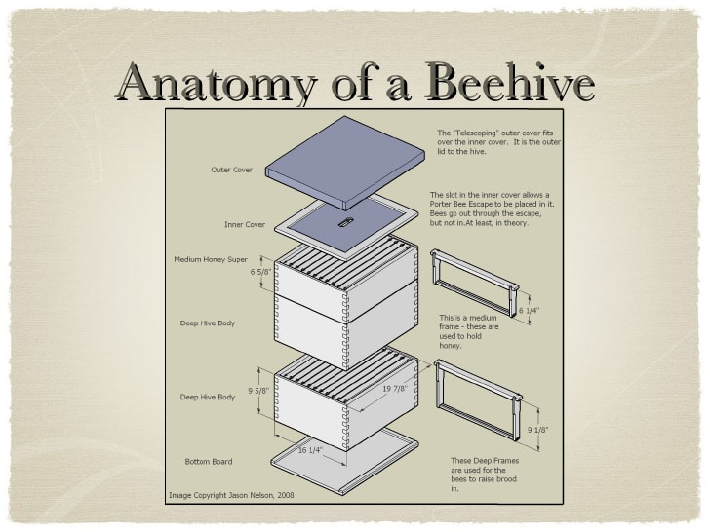

Slide 10
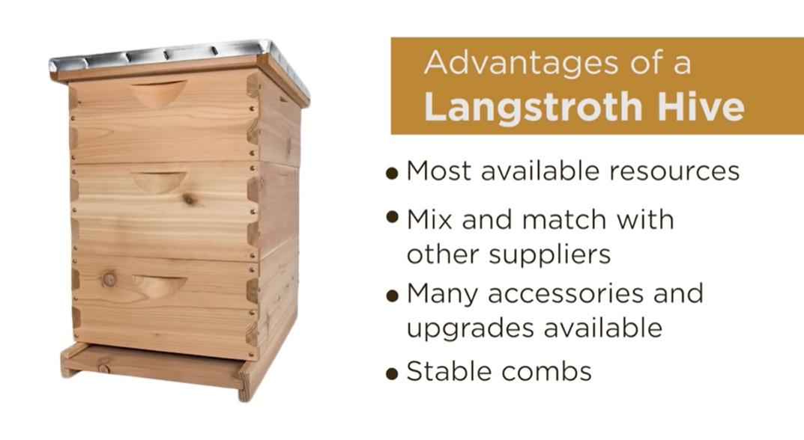

Slide 11
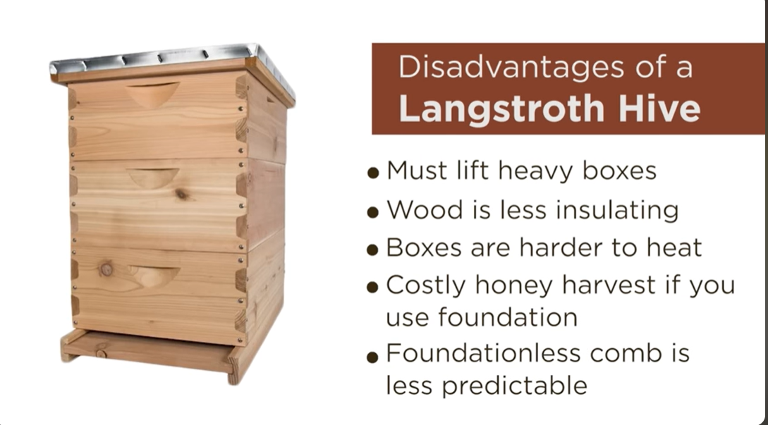

Slide 12


Slide 13
Thank You

